Slide 1
INVESTMATE

Slide 2
AGENDA
new/updates (check the bottom of the slide)
Team Members
Improvements
Problem Statement
Project Description
Team Agreement
Personas
MVP
Technologies
Algorithms
Diagrams
User Stories
Sprint 3 - Recap
Product Backlog
Sprint Summary
Test Cases
Sprint 4
Metrics
Retrospective
Product demo screenshots
Important API’s
Github Link
Wiki Link
References

Slide 3






Team Member Roles and Responsiblities
Venkatesh Nidumukkala
Ankit Mhatre
Mani Chandana Kilaru
Backend Developer
Project Manager / ML Engineer
Front End Developer
Tejaswi Koppula
Uma Maheshwari Bichinepally
Charan Raju m
Backend Developer
UI/UX Developer
Tester

Slide 4
IMPROVEMENTS FROM FEEDBACK
Added User stories
Remove market Analysis
Removed tech jargons from MVP
Technologies explained
AP and user stories on same page
Added User story Id
Added Test case Id
Mapped Test case Id and User Story Id

Slide 5
IMPROVEMENTS FROM FEEDBACK
Revamped Test cases page (looked ugly prev)
Added completion status
Fixed calculation for story point completion(extra 5 points last time)
Added Average velocity (Missing last time)
Multiple Burndown charts
Prevented Text Chopping
Only used User Story as the title

Slide 6
IMPROVEMENTS FROM FEEDBACK
(from others teams as well)
Added a little tough test cases
Added heading on every page
Added User Stories “So”
Recapped previous sprint properly
Fixed previous burndown charts
Have a big product backlog
Completed and incomplete are two different slides

Slide 7
PROBLEM STATEMENT
In the contemporary world of finance, a considerable number of young individuals aged 18 to 25 are perplexed by the dilemma of pursuing a career in this global trend, while experiencing various challenges in finding sources of practical experience and knowledge. Despite acquiring the principles taught in academic institutions, individuals encounter difficulties implementing them in real-life scenarios. This creates a proficiency gap between their educational knowledge and investment strategies, which arises from the complexities in the structure and the fear of monetary loss, a significant factor that should be addressed in the education platform. It is imperative to develop an easily understandable education platform that adopts a learner-based approach to bridge this gap.

Slide 8
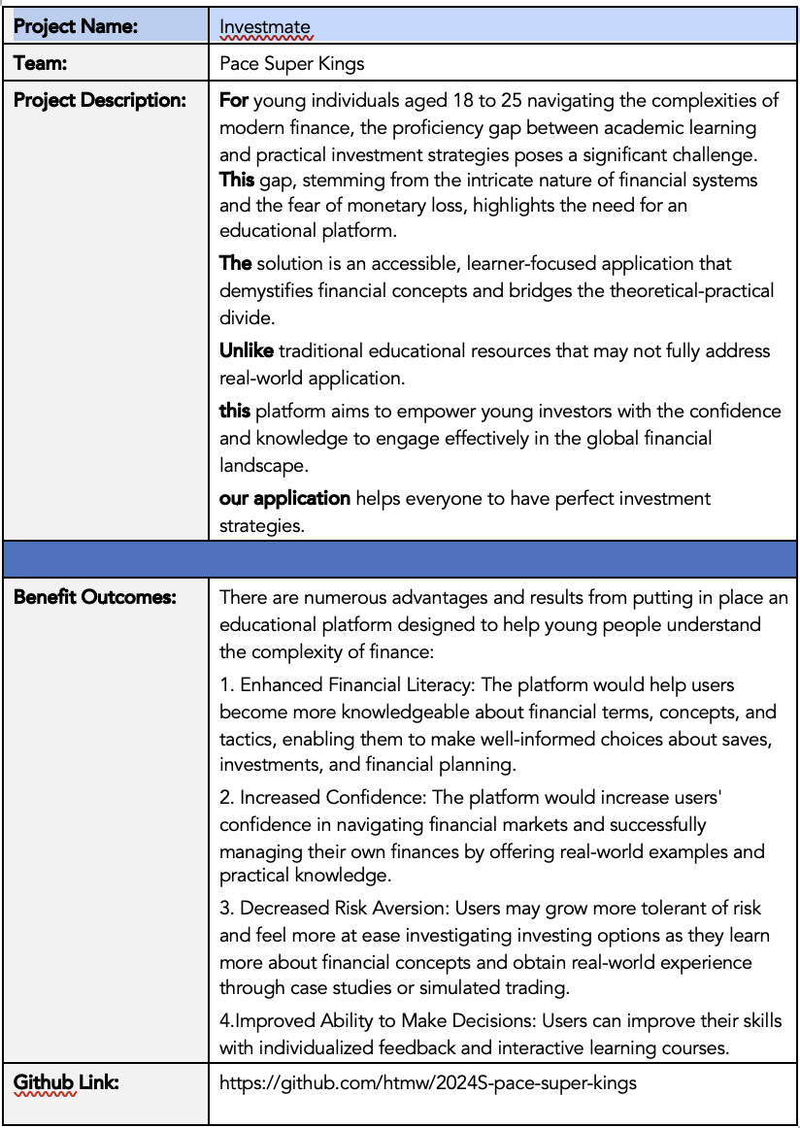
PROBLEM
DESCRIPTION

Slide 9
TEAM AGREEMENT
Each team member shall actively listen to and consider one another's opinions and perspectives, fostering an environment of open communication and constructive feedback. We will engage in respectful dialogue, valuing diverse viewpoints.
Decisions regarding project workflow will be made collectively through discussions and deliberations. We will ensure that all voices are heard, and the majority opinion will guide our actions, promoting a sense of ownership and commitment to the project.
We are committed to upholding the highest standards of professionalism at all times. Inappropriate behavior, such as disrespect, discrimination, or harassment, is strictly prohibited. Any instances of misconduct shall be promptly reported to the team leader or project supervisor for appropriate action, ensuring a safe and inclusive working environment for all team members.
Recognizing the unique strengths and expertise of each team member, we will leverage our collective talents to contribute effectively to the project. We will actively seek opportunities to collaborate, support, and assist one another, fostering a culture of mutual respect and cooperation. Through our combined efforts, we will strive for excellence in all aspects of our work.
Regular team meetings will be crucial forums for discussion, planning, and decision-making. We will actively participate in these meetings, sharing updates on our progress, addressing challenges, and brainstorming solutions collaboratively.
All team members must attend all scheduled meetings. In the event of unavoidable conflicts, timely communication and proactive efforts to reschedule or catch up on missed discussions will be prioritized, ensuring that no team member is left behind.
We are committed to meeting all assigned tasks and deadlines promptly, demonstrating reliability and accountability in our work. Should any team member encounter difficulties or require assistance, we will proactively seek help from our peers, fostering a culture of support and collaboration.
Recognizing the importance of timely completion, we understand that extensions beyond agreed deadlines will be granted with seriousness. We will prioritize effective time management and proactive communication to ensure the successful execution of our project deliverables.
Clear and transparent communication is essential for effective collaboration. We will utilize Slack as our primary communication platform, actively engaging in discussions, sharing updates, and seeking clarification when needed.
All team members are expected to participate in Slack discussions regularly, responding promptly to messages and actively contributing to the exchange of ideas. Through our collective efforts, we will maintain open lines of communication, fostering a culture of transparency and collaboration.

Slide 10
PERSONAS

Slide 11
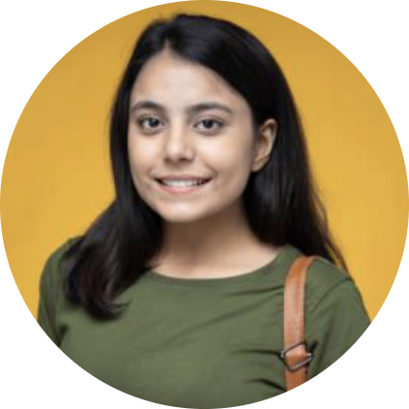
PERSONA - 1
Name: Priya
Age: 23
Occupation: College student in the final year, aspiring to start her own business.
Investment Experience: Minimal experience.
Goals: To acquire investment management skills for better financial management.
Challenges: Unable to balance academic responsibilities, entrepreneurial planning and investment learning.

Slide 12

PERSONA - 2
Name: Sara
Age: 20
Occupation: College student majoring in English Literature.
Investment Experience: None.
Goals: Interested in learning about personal finance and investing to start saving for the better future
Challenges: Unable to understand the financial terms

Slide 13

PERSONA - 3
Name: Michael
Age: 25
Occupation: College student majoring in finance.
Investment Experience: No practical experience.
Goals: To gain hands-on experience in the stock market using his classroom knowledge.
Challenges: Finds it difficult to apply his theoretical knowledge in real-world

Slide 14
MINIMAL VIABLE PRODUCT (MVP)

Slide 15
MINIMAL VIABLE PRODUCT (MVP)
An online platform for stock market enthusiasts, to learn in a module by module manner
A trading simulator for novice traders to learn practically in a simulated environment for the trader to not lose real money.
Daily Risk Assessment based on the orders placed for understanding progress.

Slide 16
TECHNOLOGIES

Slide 17


FRONTEND
Component based reusable UI elements
Rich Ecosystem of libraries
Wide Community support
16 types, animation ready, light weight.
Free for Educational and commercial use.
Interoperable with ReactJS

Slide 18


BACKEND
Well suited for microservices architecture
Asynchronous I/O, event driven architecture.
Express.js support, reduces web server development efforts
Light-weight microweb framework in Python
Multiple Concurrent request support
Easy integration with PyTorch specially YOLOv8

Slide 19


STORAGE and DATABASES
Flexible Schema, JSON like.
Document-Oriented Design(hierarchical), well suited to our needs
Lesser learning curve, if familiar with JSON
Faster Content Delivery.
For communication with market prediction algorithm, b/w NodeJS and Flask server
Access control lists and bucket policies.

Slide 20


DEPLOYMENT PLATFORM
Well suited for microservices architecture
Asynchronous I/O, event driven architecture.
Express.js support, reduces web server development efforts
Free for a year with Github education
api.investmatefinance.tech

Slide 21


DEVOPS
Provided isolation for application and dependencies
Easy to maintain consistent environment across dev cycle.
Declarative way to define and manage multi-container applications.
Reducing complicated deployment efforts.
Continuous Deployment(reducing ttd to 25s)
DNS panel and SSL certificates included.
Static site Hosting(reducing complex server infra)
investmatefinance.tech

Slide 22


EXTRAS
Slack for team communication
Automated Testing
Collaborative
Environment variables support
Documentation ready

Slide 23


MACHINE LEARNING
Wide range of pretrained models for NLP tasks
Potentially beneficial for starting w/o a model
Tensorflow for testing the model with Google’s compute infrastructure
Ease of use, reducing model setup time by a lot.
Extensively customizable to fine tune to our needs.
5 labels, supports streaming and images both.

Slide 24
ALGORITHMS
YOLO v8
The YOLO v8 Stock Market Pattern Detection model is an object detection model based on the YOLO (You Only Look Once) framework. It is designed to detect various chart patterns in real-time stock market trading video data. The model aids traders and investors by automating the analysis of chart patterns, providing timely insights for informed decision-making. The model has been fine-tuned on a diverse dataset and achieved high accuracy in detecting and classifying stock market patterns in live trading scenarios.
LSTM
Using Seaborn and Matplotlib, analyzing the risk of a stock, based on its previous performance history. Also predicting future stock prices through a Long Short Term Memory (LSTM) method.

Slide 25
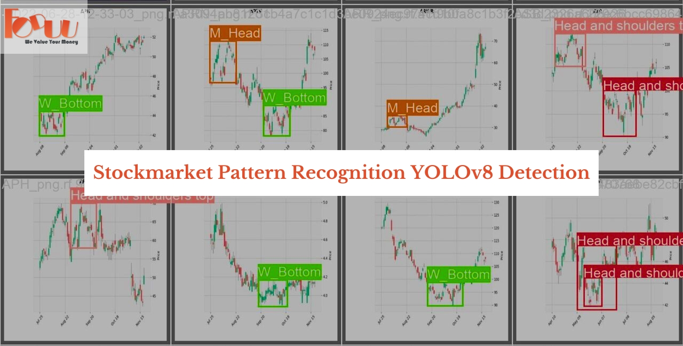

Slide 26
DIAGRAMS

Slide 27
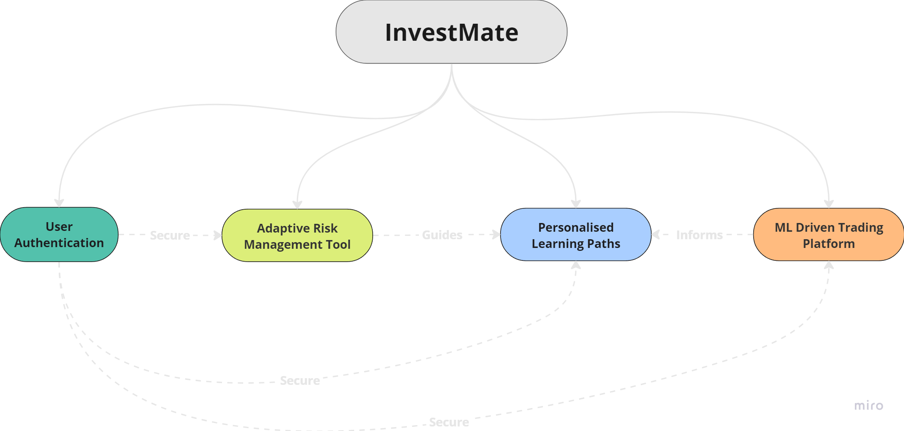
CONCEPTUAL DIAGRAM

Slide 28
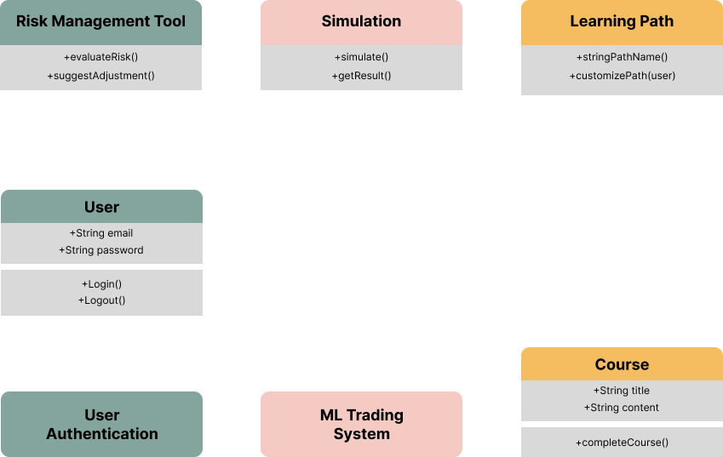
CLASS DIAGRAM

Slide 29
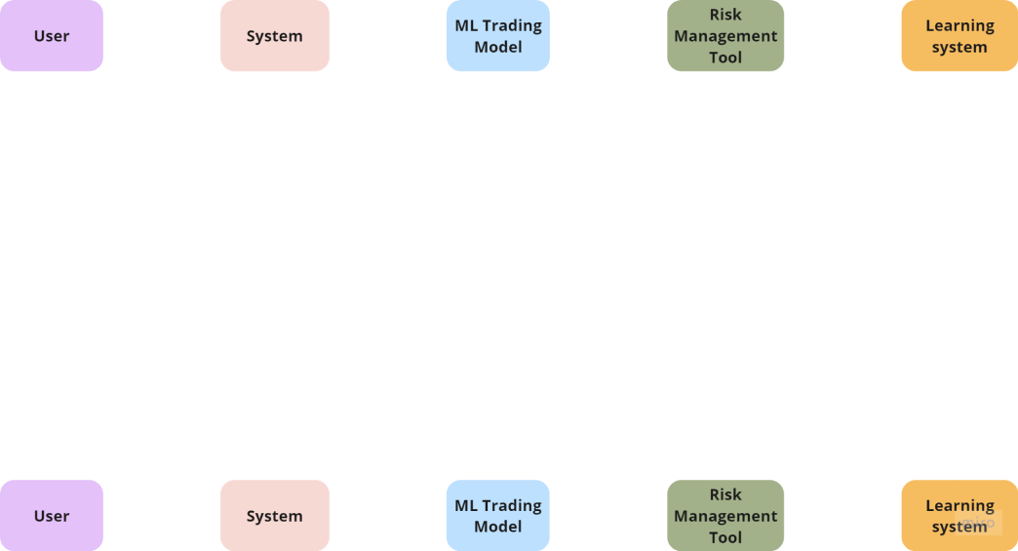
SEQUENCE DIAGRAM

Slide 30
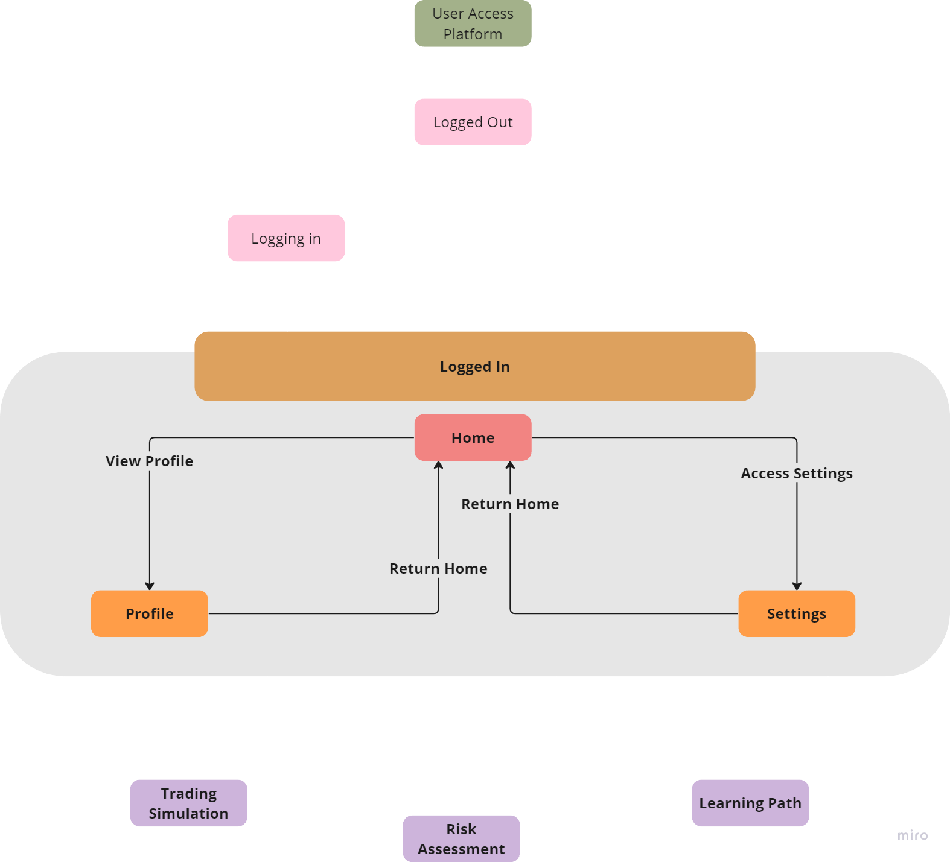
STATE DIAGRAM

Slide 31
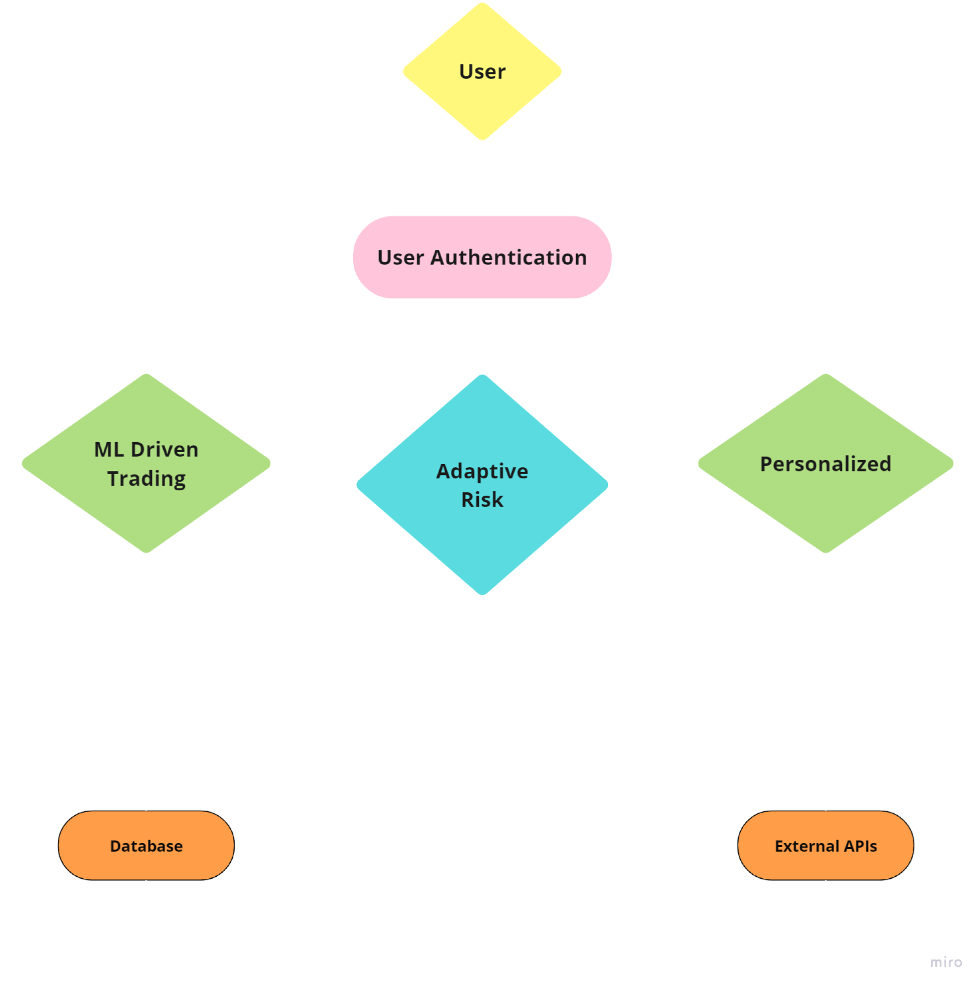
CONTEXT DIAGRAM

Slide 32
USER STORIES
User Story ID | Scenario | Summary | Acceptance Criteria | Feature
IV1 | As a new user want to create an account
 | Create an Account | The user wants to create an account to access the stock market simulator platform. | Create an account with username, password, potentially email. for Account verification. | Auth
IV2 | As a novice investor want to understand the basic concepts of the market
 | Understand the basic concepts of the market | The user wants to learn about the stock market before investing simulated money. | The platform shows chapters module by module for learning about the market analysis | Learning Pathways
IV3 | As a novice investor Set Up a Simulated Investment Account
 | Set Up a Simulated Investment Account | The user wants to create a simulated investment account to practice trading stocks. | Can access the trading engine offered by the platform | Trading Engine
IV4 | As a Novice Investor Access the platform
 | Access the platform | The user wants an individual access to the portal, where he/she can return to for the past trades | Investmate platform allows platform to be used a trading platform offered by exchanges | Auth

Slide 33
USER STORIES
User Story ID | Scenario | Summary | Acceptance Criteria | Feature
IV5 | As a Novice Investor Update personal profile
 | Update personal profile | The user wants to update his/her profile for trading. | Update the profile and fine tune, personal data. | Auth
IV6 | As a Novice Investor Search and Research Stocks
 | Search and Research Stocks | The user wants to research stocks before buying them in their simulated portfolio. | The user is able to search Stocks, retrieve charts, change the data range of the charts and the candle type | Trading Engine
IV7 | As a Novice Investor Understand the stock chart pattern
 | Understand the stock chart pattern | The user wants to understand the pattern of the currently displayed stock . | - Platform answers, the current market graph pattern | AI Chat Bot
IV8 | As a Novice Investor Understand daily risk index
 | Understand daily risk index | The user wants to understand the change in his/her risk index over time. | - Platform calculates daily risk | Risk Assessment(Research)

Slide 34
USER STORIES
User Story ID | Scenario | Summary | Acceptance Criteria | Feature
IV9 | As a Novice Investor Buy and Sell Stocks in Smaller Quantities
 | Buy and Sell Stocks in Smaller Quantities | The user wants to start with smaller simulated trades to build confidence. | - Platform allows buying/selling in fractional shares or smaller lot sizes. - Educational resources explain fractional shares. | Trading Engine
IV10 | As a Novice Investor Track placed orders
 | Track placed orders | The user wants to easily understand their simulated portfolio's performance. | Go to the orders tab and see a list of all the orders placed in the history | Trading Engine
IV11 | As a Novice Investor Practise unlimited trades
 | Practise unlimited trades | The user wants to practise as much as he can, keeping in mind the money limit, but still being able to start a fresh | - Able to top up the account unlimited amount of times | Trading Engine
IV12 | As a Novice Investor Backtest Investment Strategies
 | Backtest Investment Strategies | The user wants to test and evaluate different investment strategies using historical data in a simulated environment. | Tools available to create and backtest investment strategies using historical market data. Compare accuracy over time | Stock Analysis

Slide 35
USER STORIES
User Story ID | Scenario | Summary | Acceptance Criteria | Feature
IV13 | As a Novice Investor Analyze Portfolio Risk with Advanced Metrics
 | Analyze Portfolio Risk with Advanced Metrics | The user wants to perform a deeper analysis of their simulated portfolio's risk profile. | Access detailed reports and visualizations to understand potential risks associated with portfolio holdings. | Risk Assessment
IV14 | As a Novice Investor Get answers for trading questions
 | Get answers for trading questions | The user wants answers related to stock market as an financial instrument. | - Platform answers stock market related question | AI Chat Bot
IV15 | As a Novice Investor Access the platform from any location
 | Access the platform from any location | The user wants to connect to the platform from not only one particular network/location | - Accessible platform from any physical location | Dev-Ops

Slide 36
RECAP

Slide 37
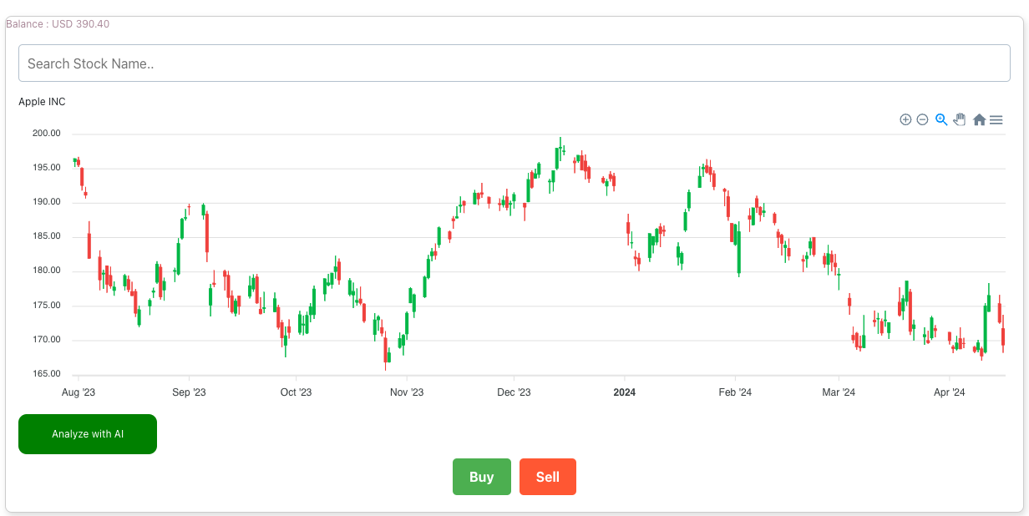
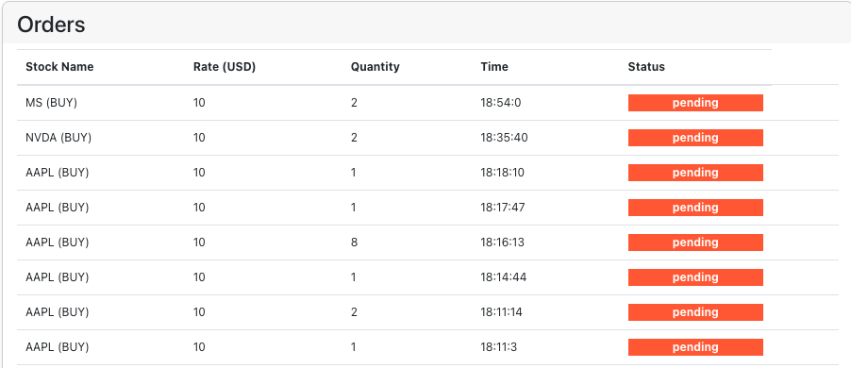
SPRINT 3 - Recap
Able to search real time stock tickers
Place orders
Built an exchange to handle trades (buy and sell)
Able to add (virtual)money to the demo account.
View stock data for last 180 days
Learning modules, for a novice investor to learn new market concepts.

Slide 38
PRODUCT BACKLOG

Slide 39
PRODUCT BACKLOG
Sprint | Points | Story ID | Feature | As a | I want | So that
2 | 13 | IV1 | Auth | New User | to create an Account | Persist my data and later continue from the same, maintain confidentiality
3 | 5 | IV2 | Learning Pathways | Novice Investor | to understand the basic concepts of the market | I can learn module by module for learning about the market analysis
2 | 1 | IV3 | Trading Engine | Novice Investor | to set up a Simulated Investment Account | I can access the trading engine offered by the platform
2 | 5 | IV4 | Auth | Novice Investor | to be able to access the platform | the platform allows platform to be used a trading platform offered by exchanges
2 | 5 | IV5 | Auth | Novice Investor | to be able to update personal profile | I can fine tune, personal data for any offering from the platform
3 | 2 | IV6 | Trading Engine | Novice Investor | to search and Research Stocks | I am able to search Stocks, retrieve charts, change the data range of the charts and the candle type
4 | 13 | IV7 | AI Chat Bot | Novice Investor | to understand the stock chart pattern | I know what the current market graph pattern is.
Sprint 2 |  |  | Sprint 3 |  |  | Sprint 4 |  |  | Sprint 5

Slide 40
PRODUCT BACKLOG
Sprint | Points | Story ID | Feature | As a | I want | So that
3 | 2 | IV8 | Risk Assessment(Research) | Novice Investor | to understand daily risk index | I measure my improvement
3 | 5 | IV9 | Trading Engine | Novice Investor | to buy and Sell Stocks in Smaller Quantities | i can learn placing orders in real markets
3 | 5 | IV10 | Trading Engine | Novice Investor | to track placed orders | to watch the changing prices, and decide to sell
3 | 5 | IV11 | Trading Engine | Novice Investor | to practise unlimited trades | there is no hindrance in my learning journey
5 | 8 | IV12 | Stock Analysis | Novice Investor | to backtest Investment Strategies | to learn diverse trading strategies
4 | 8 | IV13 | Risk Assessment | Novice Investor | to Analyze Portfolio Risk with Advanced Metrics | to measure my progress and change my strategy in real markets
4 | 8 | IV14 | AI Chat Bot | Novice Investor | to get answers for trading questions | to understand why things happen a certain way
Sprint 2 |  |  | Sprint 3 |  |  | Sprint 4 |  |  | Sprint 5

Slide 41
SPRINT SUMMARY

Slide 42
SPRINT 2
User Story Id | User Story | Points | Status
IV1 | Create an Account | 13 | COMPLETE
As a new user, I want all the trades and progress related to me persist for me individually
IV3 | Set Up a Simulated Investment Account | 1 | COMPLETE
As a registered novice investor, I want to able to start trading and search for stocks
IV4 | Access the platform | 5 | COMPLETE
As a registered novice investor, I want to able to access learning modules and the risk assessment daily
IV5 | Update personal profile | 5 | COMPLETE
As a registered novice investor, I want to able to access information specific to me, and be able to change it.

Slide 43
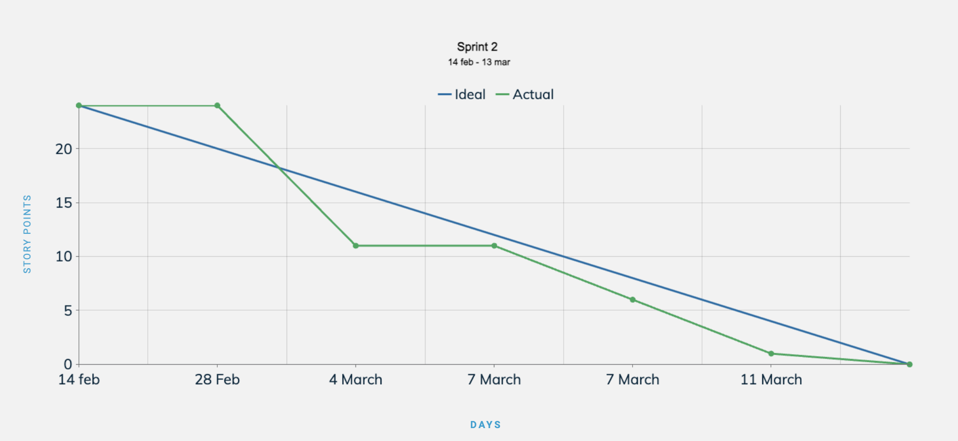
SPRINT 2 - Burndown

Slide 44
SPRINT 3
User Story Id | User Story | Points | Status
IV2 | Understand the basic concepts of the market | 5 | COMPLETE
As a novice Investor, I want to learn about the basic fundamentals of the stock financial instrument
IV6 | Search and Research Stocks | 2 | COMPLETE
As a novice Investor, I want to be able to search stocks, and see their past stock data for at least 60 days
IV8 | Understand daily risk index (Research) | 2 | COMPLETE
As a novice Investor, I want to be able to understand and calculate my daily risk wrt my trading patterns
IV9 | Buy and Sell Stocks in Smaller Quantities | 5 | COMPLETE
As a novice Investor, I want to place trades both buy and sell orders
IV10 | Track placed orders | 5 | COMPLETE
As a novice Investor, I want to be able to glance over through my already placed orders
IV11 | Practise unlimited trades | 5 | COMPLETE
As a novice Investor, I want to never run out of demo currency, and practice unlimited number of times

Slide 45
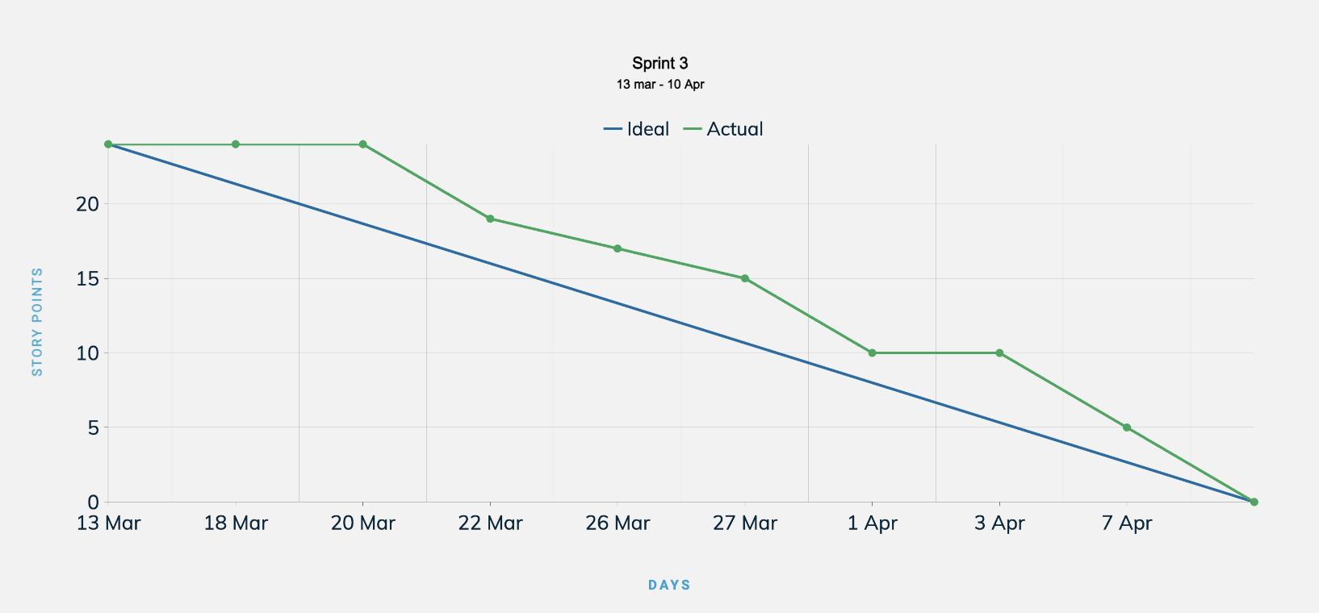
SPRINT 3 - Burndown

Slide 46
SPRINT 4 BACKLOG
Estimation | User Story ID | Feature | User Story | Acceptance Criteria | Description
13 | IV7 | AI Chat Bot | Understand the stock chart pattern | - Platform answers, the current market graph pattern | The user wants to understand the pattern of the currently displayed stock .
8 | IV13 | Risk Assessment | Analyze Portfolio Risk with Advanced Metrics | - Advanced risk analysis tools with metrics like Value at Risk (VaR) and Monte Carlo simulations. - Access detailed reports and visualizations to understand potential risks associated with portfolio holdings. | The user wants to perform a deeper analysis of their simulated portfolio's risk profile.
8 | IV14 | AI Chat Bot | Get answers for trading questions | - Platform answers stock market related question | The user wants answers related to stock market as an financial instrument.
8 | IV15 | Dev-Ops | Access the platform from any location | - Accessible platform from any physical location | The user wants to connect to the platform from not only one particular network/location

Slide 47
TEST CASES

Slide 48
TEST CASES - Sprint 4
Test Case ID | User Story ID | Description | Test Steps | Expected Results | Actual Results | Status
TCIV-8 | IV7 | User opens a stock chart for a specific company (e.g., Apple). The platform successfully identifies and displays the current chart pattern (e.g., Head and Shoulders). | 1. User navigates to the stock chart for a particular company (e.g., Apple). | The platform displays the stock chart and identifies a pattern (e.g., Head and Shoulders) with a visual representation and/or textual label. | The platform displays the stock chart and identifies the expected pattern. | PASS
TCIV-9 | IV7 | User opens a stock chart with limited data points. The platform displays a message indicating insufficient data to determine a pattern. | 1. User navigates to the stock chart for a company with minimal historical data (e.g., newly IPO'd company). | The platform displays the stock chart with a message indicating insufficient data for pattern recognition. | The platform displays the stock chart with the expected message about insufficient data. | FAIL
TCIV-10 | IV7 | User opens a completely flat stock chart. The platform displays a message indicating no clear pattern detected. | 1. User navigates to the stock chart for a company with a flat price movement over a period. | The platform displays the stock chart with a message indicating no clear pattern detected. | The platform displays the stock chart with the expected message about no clear pattern. | PASS

Slide 49
TEST CASES - Sprint 4
Test Case ID | User Story ID | Description | Test Steps | Expected Results | Actual Results | Status
TCIV-11 | IV14 | User asks the chatbot a question about a specific stock market term (e.g., "What is a P/E Ratio?"). The chatbot provides a clear and accurate definition. | 1. User interacts with the chatbot and asks a question about a defined term (e.g., "What is a P/E Ratio?"). | The chatbot retrieves and displays a clear and accurate definition of the term (e.g., Price-to-Earnings Ratio). | The chatbot retrieves and displays the expected definition of the term. | Pass
TCIV-12 | IV14 | User asks the chatbot a question outside its knowledge base (e.g., "What will the stock market do tomorrow?"). The chatbot acknowledges its limitations and offers resources for further research. | 1. User interacts with the chatbot and asks a question beyond its knowledge (e.g., "What will the stock market do tomorrow?"). | The chatbot acknowledges it cannot predict the future and offers resources for further research (e.g., market news, analyst reports). | The chatbot provides the expected response acknowledging limitations and offering resources. | Pass
TCIV-13 | IV14 | User asks the chatbot a question with misspelled terminology (e.g., "Whats a PE ratio?"). The chatbot recognizes the misspelling and provides the correct answer (P/E Ratio definition). | 1. User interacts with the chatbot and asks a question with a misspelling (e.g., "Whats a PE ratio?"). | The chatbot recognizes the misspelling, corrects it internally (e.g., P/E Ratio), and provides a clear definition of the intended term. | The chatbot recognizes the misspelling, corrects it, and delivers the expected definition. | Pass

Slide 50
TEST CASES - Sprint 4
Test Case ID | User Story ID | Description | Test Steps | Expected Results | Actual Results | Status
TCIV-14 | IV14 | User asks the chatbot a question with an open-ended format (e.g., "Is this stock a good buy?"). The chatbot avoids providing financial advice and directs the user to conduct their own research while offering relevant information (e.g., historical performance, analyst ratings). | 1. User interacts with the chatbot and asks an open-ended question about a stock's buying potential. | The chatbot avoids giving financial advice, encourages the user to do their own research, and offers relevant data points (e.g., historical price charts, analyst ratings). | The chatbot provides the expected response, avoiding advice and offering relevant information. | Fail
TCIV-15 | IV15 | User logs in to the platform from a web browser on a laptop computer. The platform loads successfully. | 1. User opens a web browser on a laptop and attempts to log in to the platform. | The platform successfully authenticates the user and displays the main interface. | The platform allows user login and displays the expected interface. | Pass
TCIV-16 | IV15 | User logs in to the platform from a mobile app on a smartphone using a cellular network connection. The platform loads successfully. | 1. User opens the platform's mobile app on a smartphone with a cellular data connection and attempts to log in. | The platform successfully authentic |  | Pass

Slide 51
SPRINT 4

Slide 52
SPRINT 4 - Stories Complete
User Story Id | User Story | Points | Status
IV7 | Understand the stock chart pattern | 13 | COMPLETE
As a novice Investor, I want to understand the pattern of the currently displayed stock .
IV14 | Get answers for trading questions | 8 | COMPLETE
As a novice Investor, I want answers related to stock market as an financial instrument.
IV15 | Access the platform from any location | 8 | COMPLETE
As a novice Investor, I want to connect to the platform from not only one particular network/location

Slide 53
SPRINT 4 - Stories Not complete
User Story Id | User Story | Points | Status
IV13 | Analyze Portfolio Risk with Advanced Metrics | 8 | INCOMPLETE
As a novice Investor, I want to perform a deeper analysis of their simulated portfolio's risk profile.

Slide 54
METRICS

Slide 55
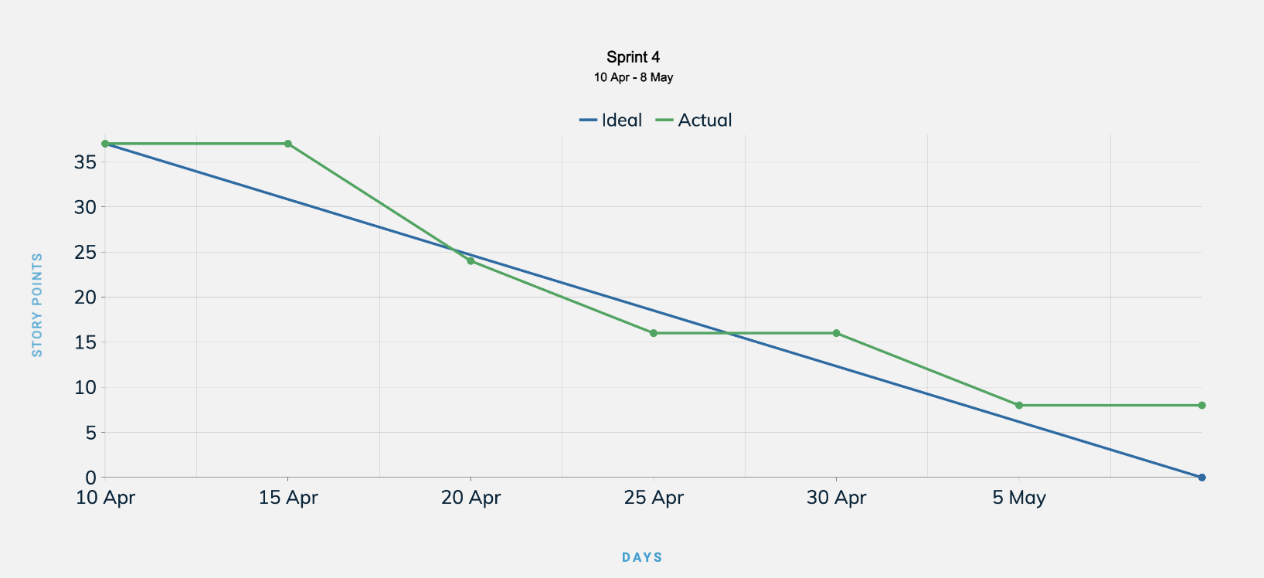
SPRINT 4 - Burndown

Slide 56
TEAM VELOCITY
Sprint 2 - 24 story points
Sprint 3 - 24 story points
(current) Sprint 4 - 29 story points
(average) - 25.67 story points
(historical) - 24 story points

Slide 57
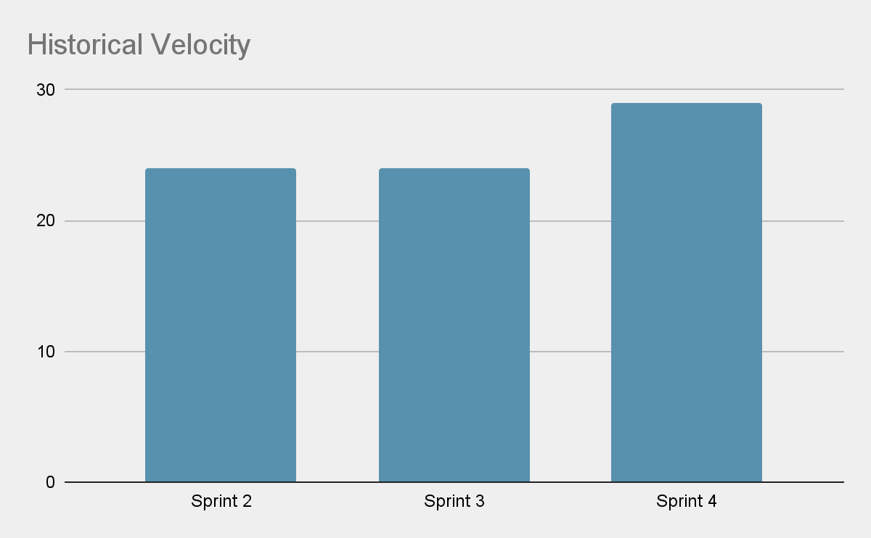
HISTORICAL VELOCITY

Slide 58
COMPLETED/COMMITTED RATIO
Sprint 2 - 100%
Sprint 3 - 100%
(current) Sprint 4 - 78.3%
(average) - 92.76%
(historical) - 100%

Slide 59
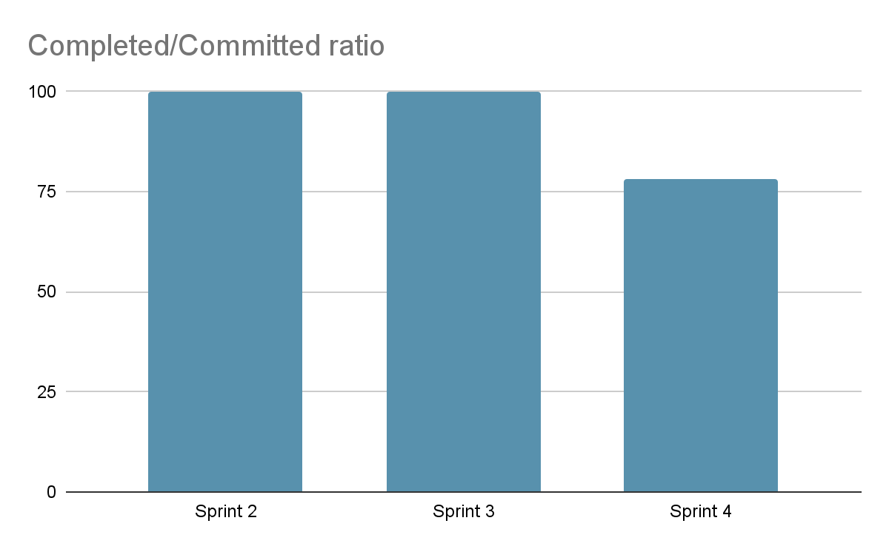
HISTORICAL VELOCITY

Slide 60
RETROSPECTIVE

Slide 61
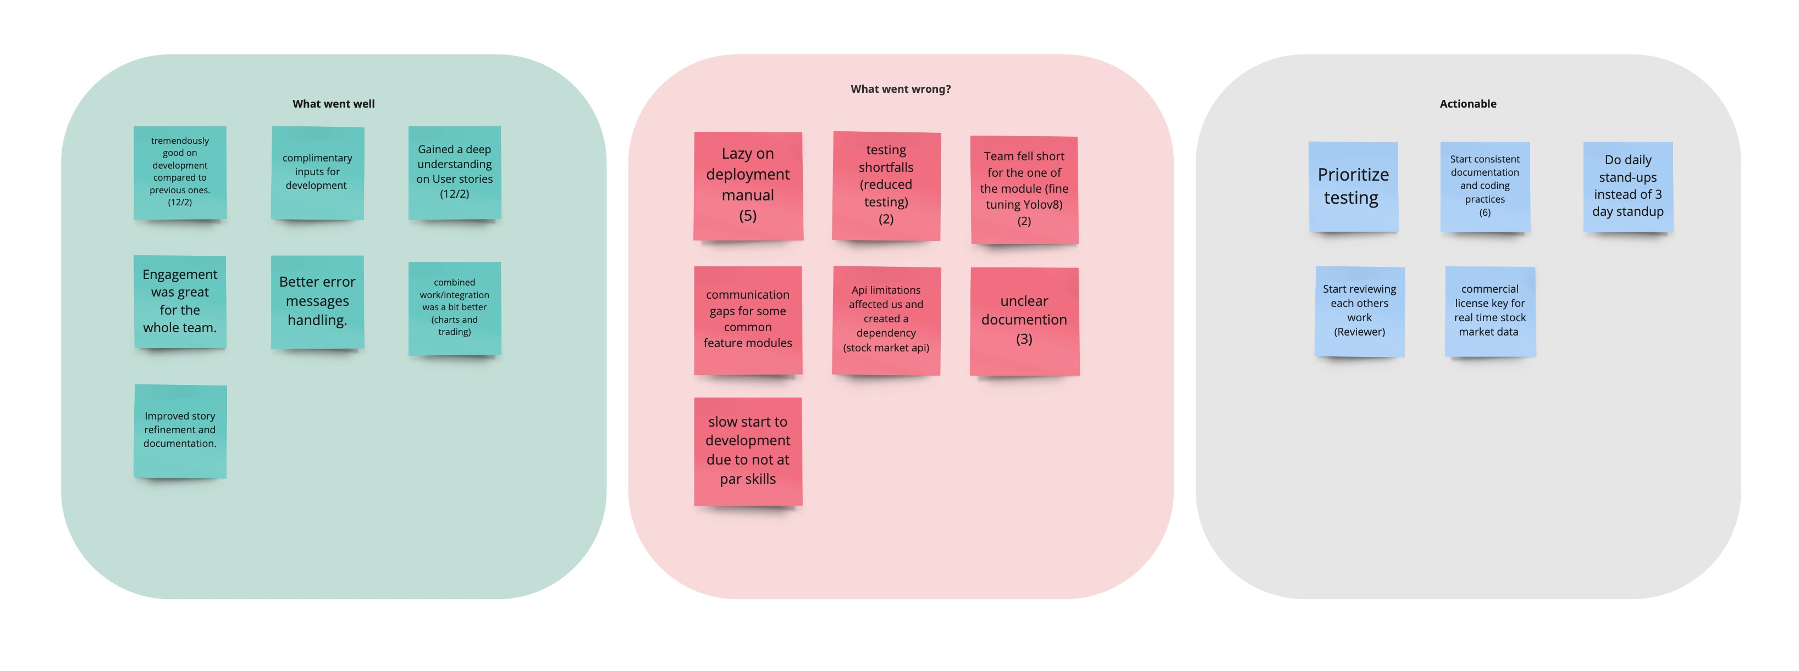
RETROSPECTIVE

Slide 62
PROJECT DEMO
SCREENSHOTS

Slide 63
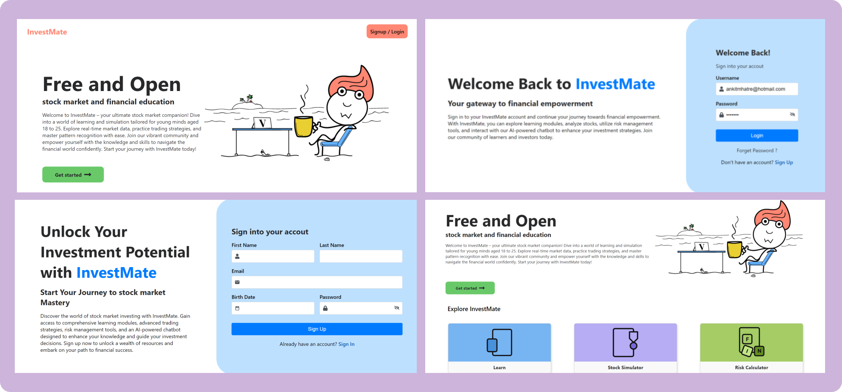

Slide 64
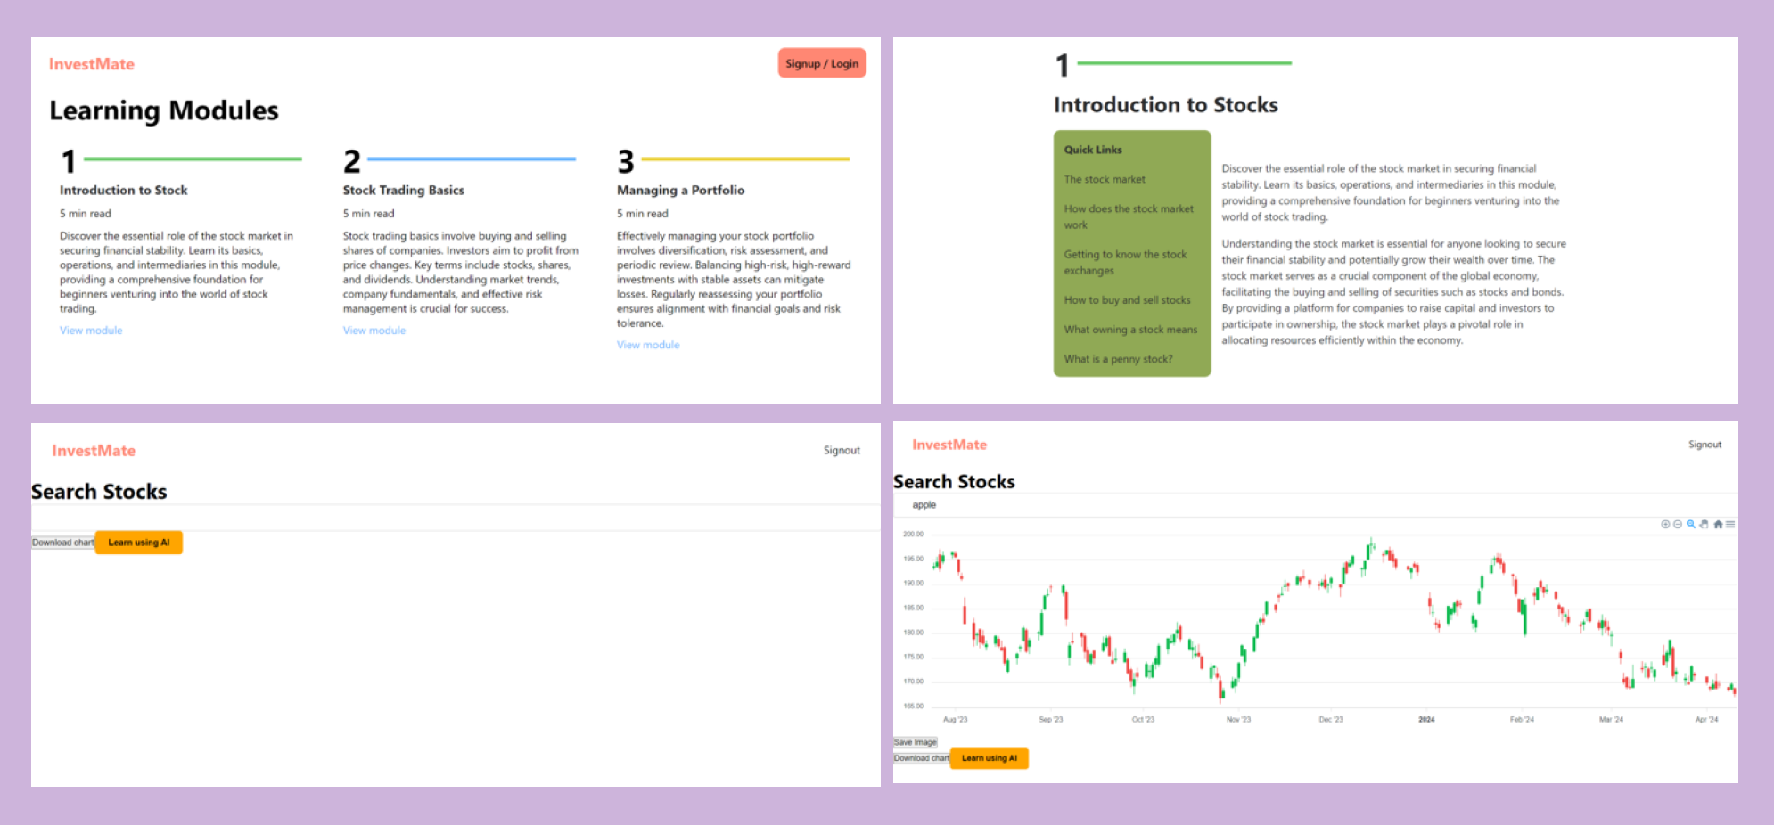

Slide 65
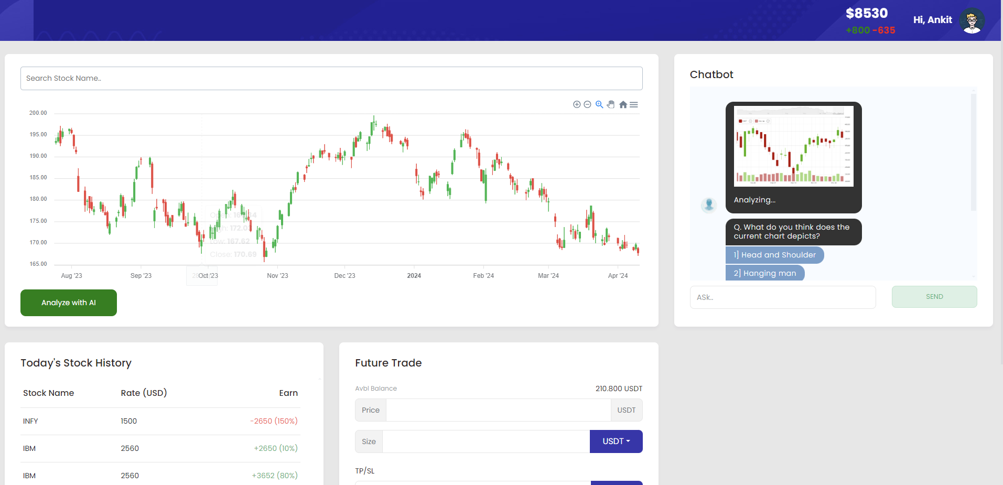

Slide 66
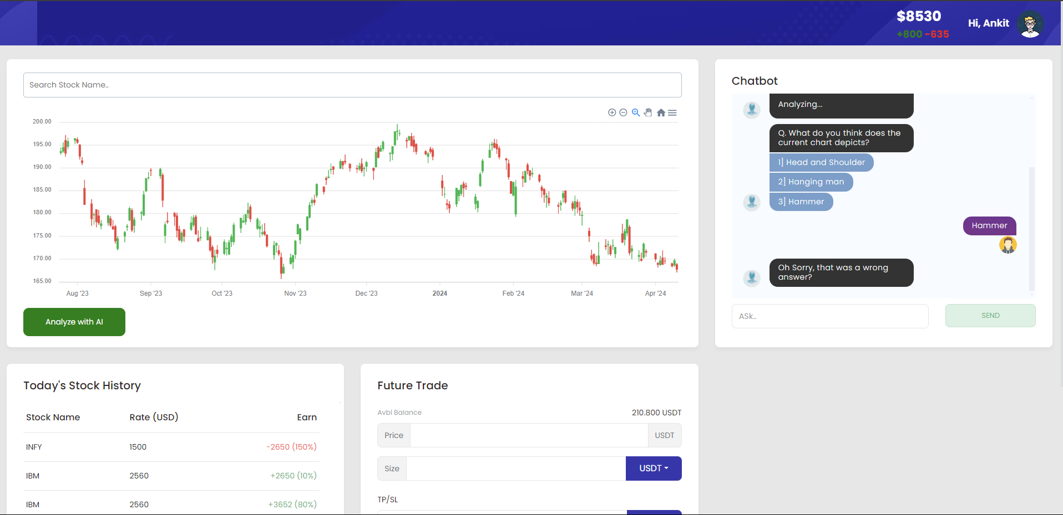

Slide 67
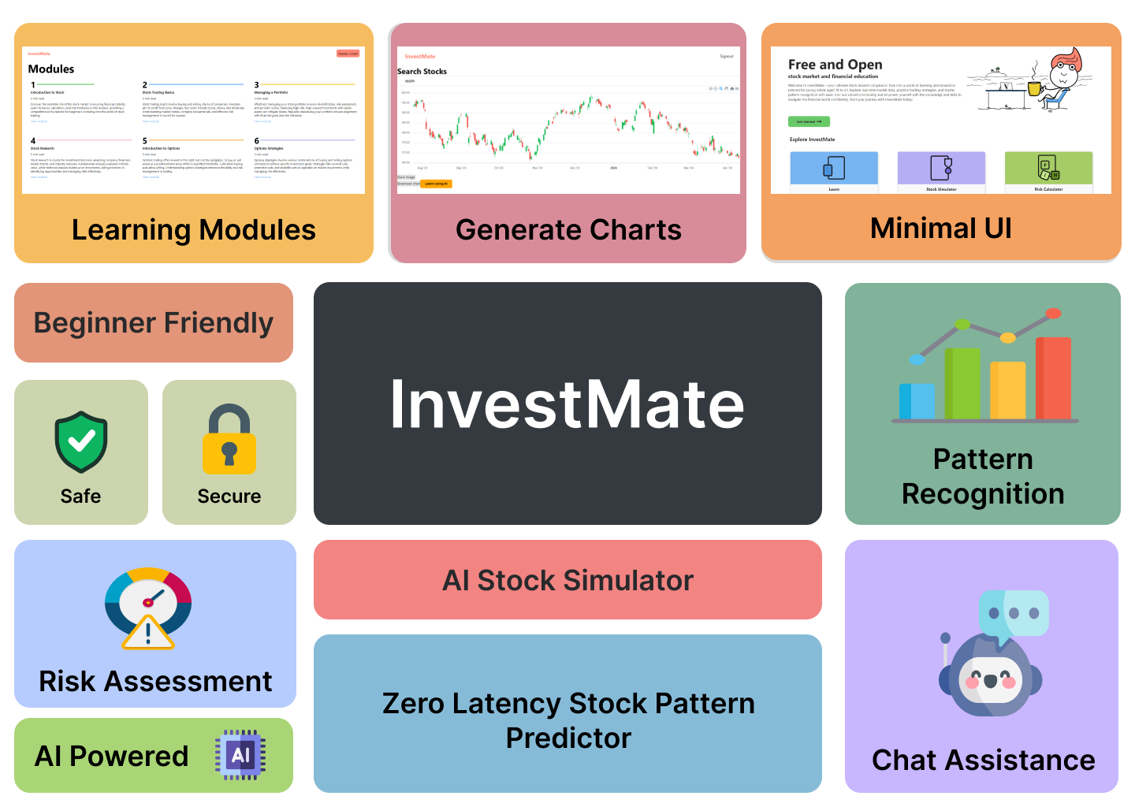

Slide 68
IMPORTANT API’s
Yahoo Finance (https://finance.yahoo.com)
Financial Modelling Prep (https://financialmodelingprep.com)
Alphavantage (https://www.alphavantage.co/)
News API (https://newsapi.org)
Apex Charts (https://apexcharts.com/)
Hugging Face (https://huggingface.co/foduucom/)
PyPi.com
NodeJS (https://nodejs.org/)
Investopedia (https://www.investopedia.com/)
Bootstrap (https://www.mdbootstrap.com/)

Slide 69
PROJECT API
SCREENSHOTS

Slide 70
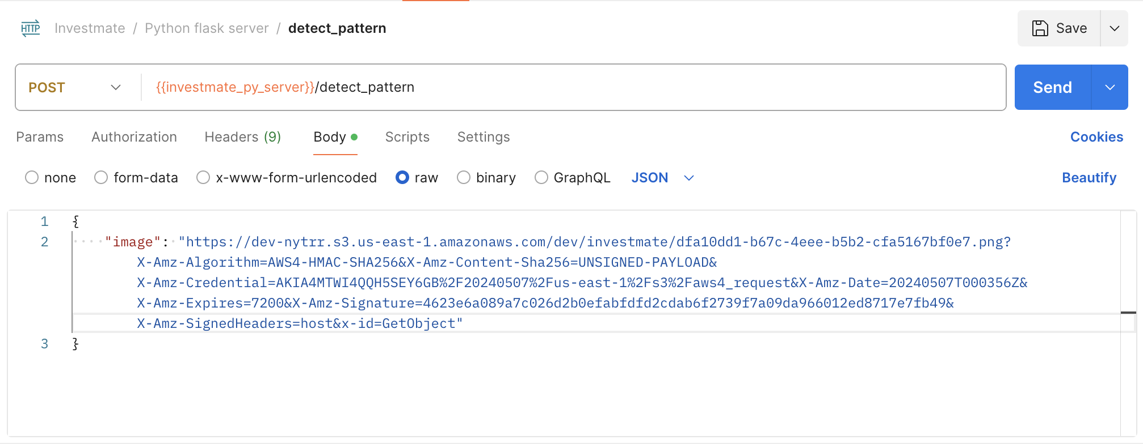
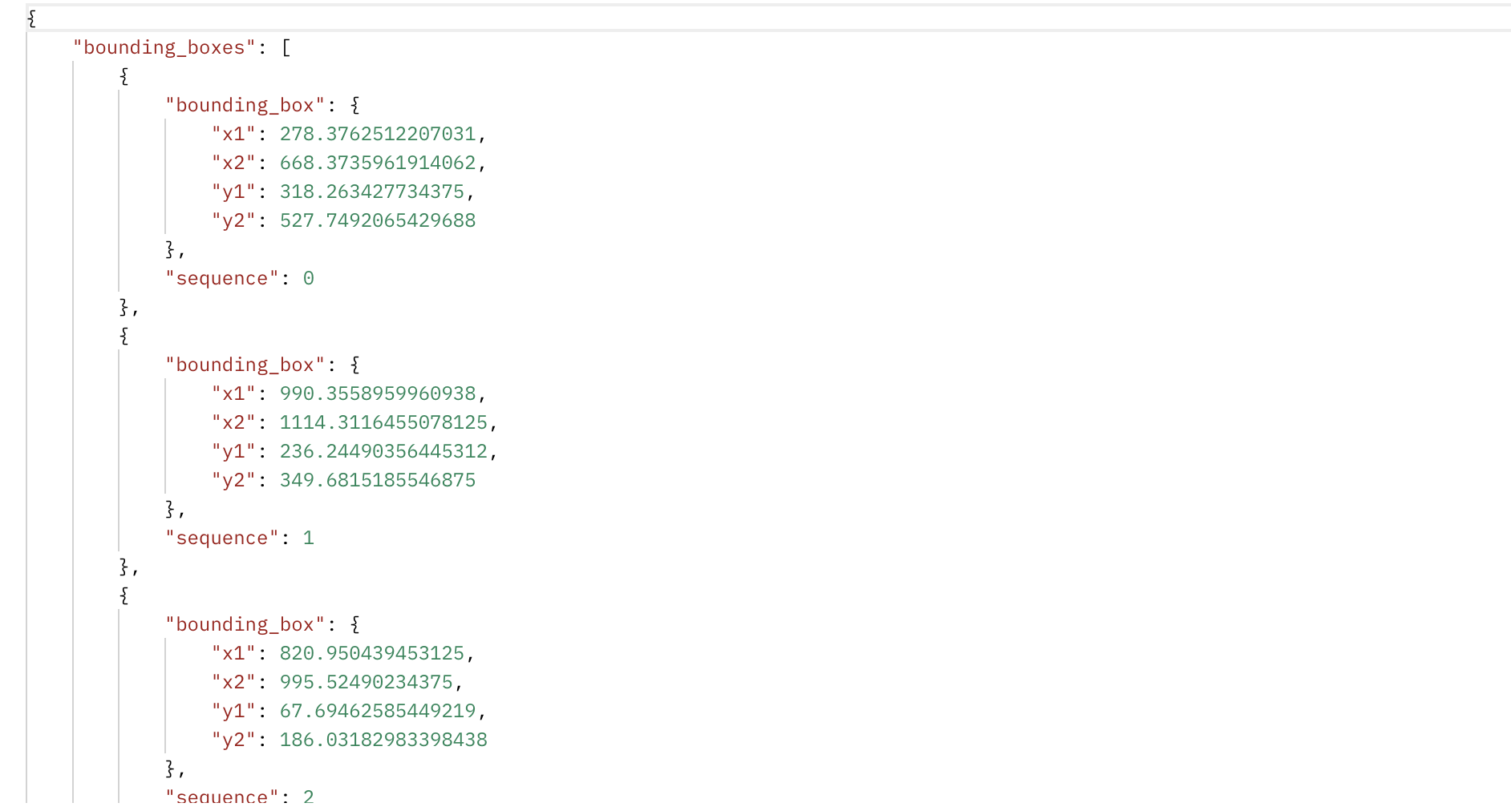
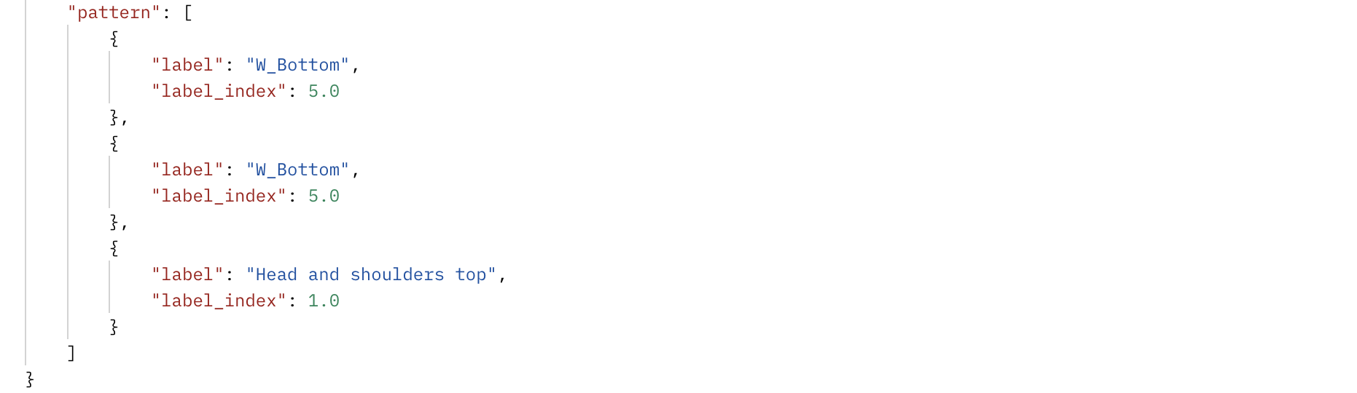

Slide 71
GITHUB
https://github.com/htmw/2024S-pace-super-kings

Slide 72
WIKI
https://github.com/htmw/2024S-pace-super-kings/wiki

Slide 73
REFERENCES
The Random Forest Model for Analyzing and Forecasting the US Stock Market in the
Context of Smart Finance
Learning Through Equity Trading Simulation
Conducting Financial Risk assessment

Slide 74
DEMO IN THE NEXT VIDEO

Slide 75
THANK YOU

